Slide 1
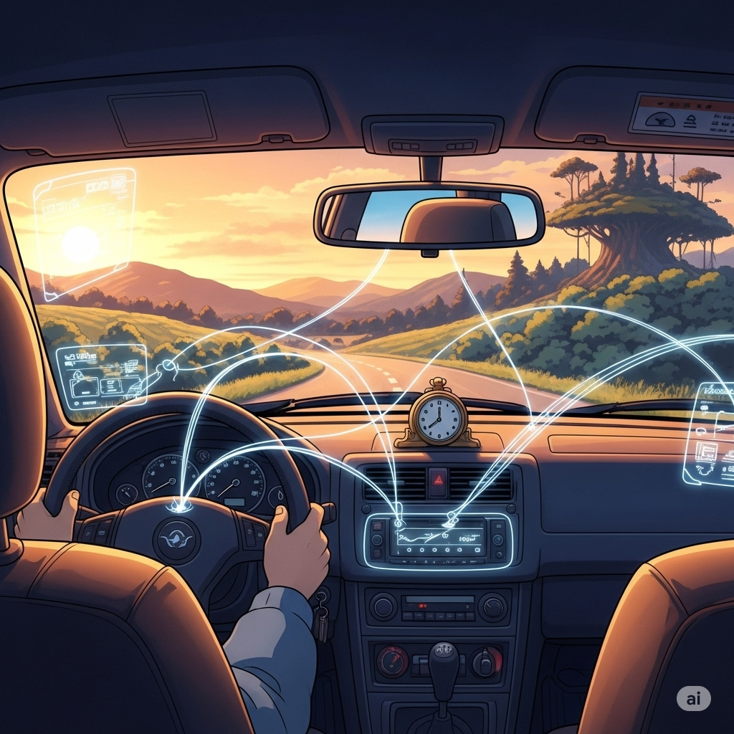
AI Driving Monitoring System
Project Proposal

Slide 2
Table of Contents
1. Introduction
2. Research Methodology
3. Project Resource
4. Project Timeline

Slide 3
Introduction
1. Introduction
2. Research Methodology
3. Project resource
4. Project Timeline

Slide 4
Introduction
Road safety remains a global issue due to fatigue and distraction.
Existing systems track are mostly wearable monitoring system or just eye-tracking system(lacking physiology).
rPPG + AI enables real-time, non-invasive monitoring using IR (or hybrid) cameras.
Goal: Detect low oxygen and fatigue. Warns drivers in real-time.

Slide 5
Project Objectives
Current systems seldom adapt to varying conditions (urban vs. rural, night vs. day, various weather conditions).
Limited integration of multi-signal monitoring (HR, SpO2, facial expressions).
Lack of longitudinal research on driver fatigue and distraction.
Concerns about user acceptance, privacy, and ethical implications.

Slide 6
Research Methodology
1. Introduction
2. Research Methodology
3. Project resource
4. Project Timeline

Slide 7
Research Methodology
Literature Review: Comprehensive review of existing research to identify gaps.
Prototype Development: Building a functional camera-based system.
Experimental Design: Creating controlled lab-based simulations.
Data Collection & Analysis: Gathering and processing data from both lab and real-world field tests.
Validation: Comparing our system's performance against existing technologies.

Slide 8
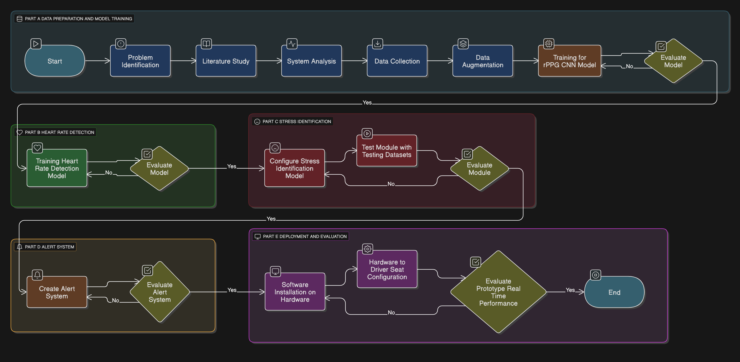

Slide 9
Project Resource
1. Introduction
2. Research Methodology
3. Project Resource
4. Project Timeline

Slide 10
Project Resource
Hardware: NIR cameras, edge device, and a pulse oximeter for ground truth data.
Software: Machine learning algorithms, with a focus on rPPG, MTCNN(Multi-task Cascaded convolutional neural netowrk), BiLSTM, and NN
Data Points: The system will monitor heart rate, oxygen saturation, respiration rate, blood pressure, and facial expressions(eye closure percentage).

Slide 11
Project Resource
This project has several resources that requests support from partner project to develop as follows:
Datasets
Camera Device
Edge computing device

Slide 12
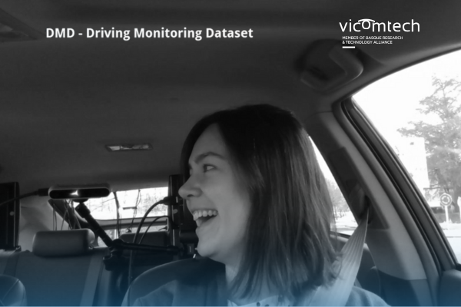
Datasets
We will be using Vicomtech Driver Monitoring Dataset(DMD). It is an opensource driver monitoring data.
There is about 25TB of raw data.
All recordings were grouped by sessions, each one determined by a protocol of activities, a participant, an environment and a lighting condition.
In each session Body, Face and Hands camera(with RBG, Infrared and Depth)
If the company can provide any data which is desired to test on, we can accommodate.

Slide 13
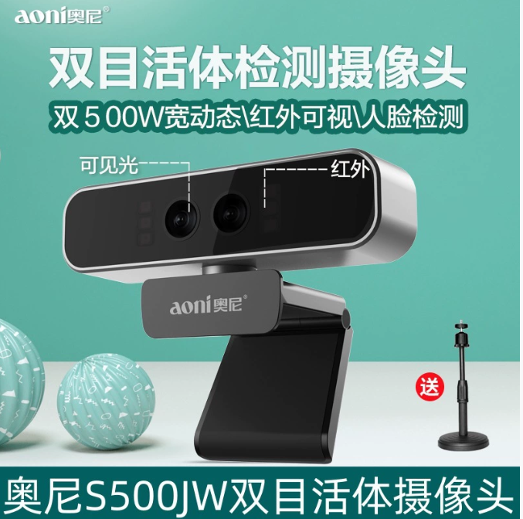
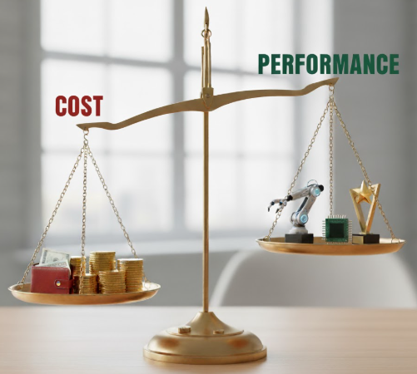
Camera
For RPPG research, normally the spec for the camera are relatively high.
  5M pixels
  Hybird NIR and RGB
But our goal is edge device implementation.
  Aim to turn into a product
  How much can we sacrifice for the cost?
Product Page Link for the camera

Slide 14
Camera
Why NIR not RGB?
  NIR according to Kong, is more robust to the detect rppg signals.
The camera must include NIR functions. It can be hybrid.
  NIR only camera can be cheaper. (NIR waveform range: 700 to 1,000 nm)
    We have experience on using 850nm and 940nm NIR camera.
    850nm captured video will turn a little purple (optimal range: <5m)
    940nm has better result in nighttime (optimal range: <3m)
  Hybrid camera (NIR+RGB) are generally more expensive.
Source: Remote Kong, L., Xie, K., Niu, K., He, J., & Zhang, W. (2024). Remote photoplethysmography and motion tracking convolutional neural network with bidirectional long short-term memory: Non-invasive fatigue detection method based on Multi-Modal Fusion. Sensors, 24(2), 455. https://doi.org/10.3390/s24020455

Slide 15
Camera
3M pixel is recommended for higher quality video capture (for 1920 x 1080 high resolution). 1M is the bare requirement (for 1200 × 650 resolution).
  The higher resolution the higher the accuracy the result will be.
  Are we willing to sacrifice a little bit off accuracy for higher performance and reduce cost?
A refresh rate of 30 Hz is our best choice. The most common refresh rate for rppg detection.
Higher refresh rates, such as 60 Hz or 120 Hz, can improve the signal quality and provide more data for advanced analysis, which requires capturing subtle beat-to-beat changes. However, these higher rates also increase the computational load and file sizes
Wondering if the company have any suggestion on the camera?

Slide 16
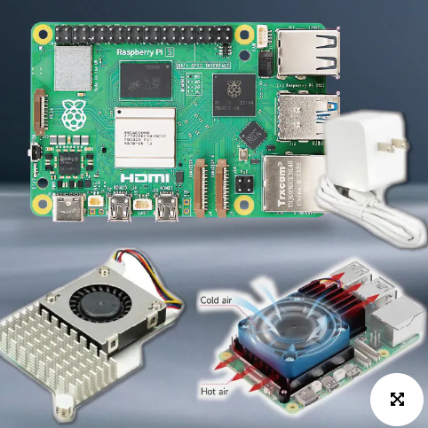
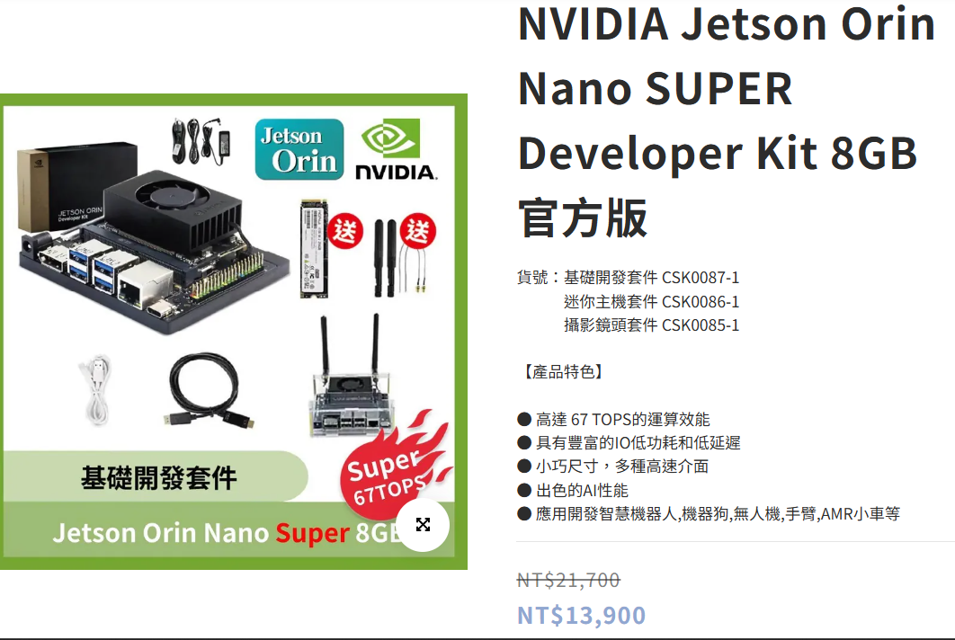
Edge computing device
          Options
          Raspberry Pi 5 (8GB): ( 3800 NTD) These are general-purpose, single-board computers. The RPi 5 has a more powerful CPU but still lacks a dedicated, high-performance GPU for AI.
          Jetson Orin Nano Super Developer Kit: (Around NT$21,700) Jetson Orin Nano Super 8GB module with an NVIDIA Ampere architecture GPU, which includes 1024 CUDA cores and 32 Tensor cores, and a 6-core Arm Cortex-A78AE v8.2 64-bit CPU, delivering up to 67 TOPS of AI performance.

Slide 17
Edge Device
Older models and research are mostly running on Raspberry pi
The current newest model and best result was not run on edge device.
  The experimental equipment and environment included:
    A computer running a Windows 11 64-bit operating system.
    Intel i9 2.20 GHz processor.16 GB of memory.
    An NVIDIA RTX 4060 GPU.
If we want to run on edge device the system needs to be robust, and specialize running AI model and parallel computation task.

Slide 18
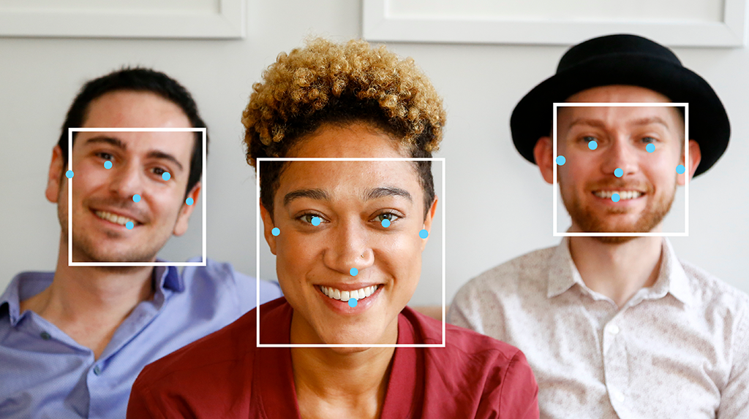
Media Pipe Face Tracking
Face Detection: A detector model first identifies the location of a face within the image or video frame.
3D Face Landmark Model: A subsequent model then takes the identified facial region and predicts the 3D coordinates of the 468 landmarks, creating a detailed mesh of the facial surface.
Have previous experience with this using rppg.

Slide 19
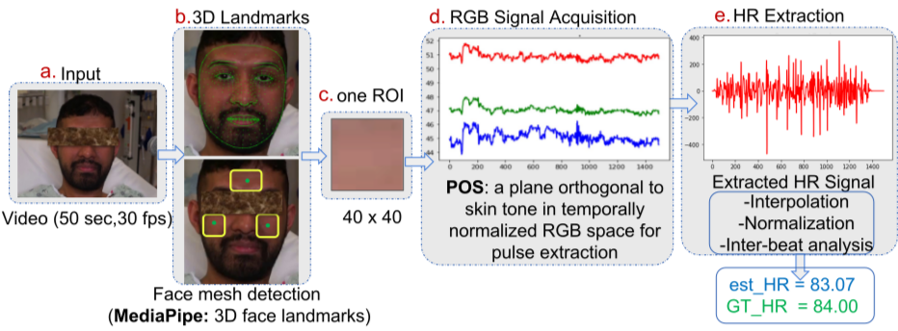
RPPG
Blood Flow and Color: With each heartbeat, blood is pumped through the vessels in your face. This surge in blood volume causes the capillaries just beneath the skin to expand, slightly increasing the absorption of light.
Light Absorption: When light hits your face, your skin reflects it. Hemoglobin in your blood absorbs green light more than red or blue light.
Camera as a Sensor: As blood pulses through your face, the amount of light reflected back to the camera changes periodically. The camera's sensor is sensitive enough to pick up these minute color variations in the video frames.
Signal Processing: Sophisticated algorithms then analyze this raw video data, isolating the periodic signal corresponding to the heartbeat from other "noise" like motion artifacts or changes in lighting. This extracted signal, which mirrors the cardiac cycle, is then used to calculate the heart rate.

Slide 20
Component | Estimated FLOPs | Rationale
1. Face Tracking | 0.2 - 0.4 GFLOPs | This involves a lightweight face detector to find the face and a landmark tracker (like MediaPipe Face Mesh) to identify the region of interest (e.g., the forehead or cheeks) for the rPPG model.
2. rPPG Model | 0.3 - 1.0 GFLOPs | This is the core of the system. The model analyzes the subtle color changes in the selected facial region. The FLOPs here can vary significantly based on the model's complexity and its robustness to noise and motion.
3. Alert System | ~0 GFLOPs | This component is just simple conditional logic (e.g., if heart_rate > 100). Its computational cost is trivial compared to the neural networks and does not contribute to the total in a meaningful way.
Total (Typical) | ~0.8 GFLOPs | A common, well-optimized system would likely fall in this range.
Units for computational load: FLOPs (Floating-Point Operations)

Slide 21
Edge Device
Computational Demand: To process video at a smooth 10 frames per second (FPS), the device would need to handle:
0.8 GFLOPs/frame×10 FPS=8 GFLOPS
Target FPS: 30
0.8 GFLOPs/frame×30 FPS=24 GFLOPS
-Raspberry Pi 5 can handle around 5-9 GFLOPS
-If the operation is 24 GFLOPS, mid-range edge devices will not be able to handle.

Slide 22
Device | Key Feature | Pros | Cons
NVIDIA Jetson Orin Nano | Integrated Ampere GPU | Most powerful, direct software path from research, mature AI ecosystem. | Higher cost, slightly higher power draw.
Raspberry Pi 5 + Coral USB | Modular (SBC + Accelerator) | Lowest cost, highly flexible, large community support. | More complex setup, potential for USB bottlenecks, less integrated.

Slide 23
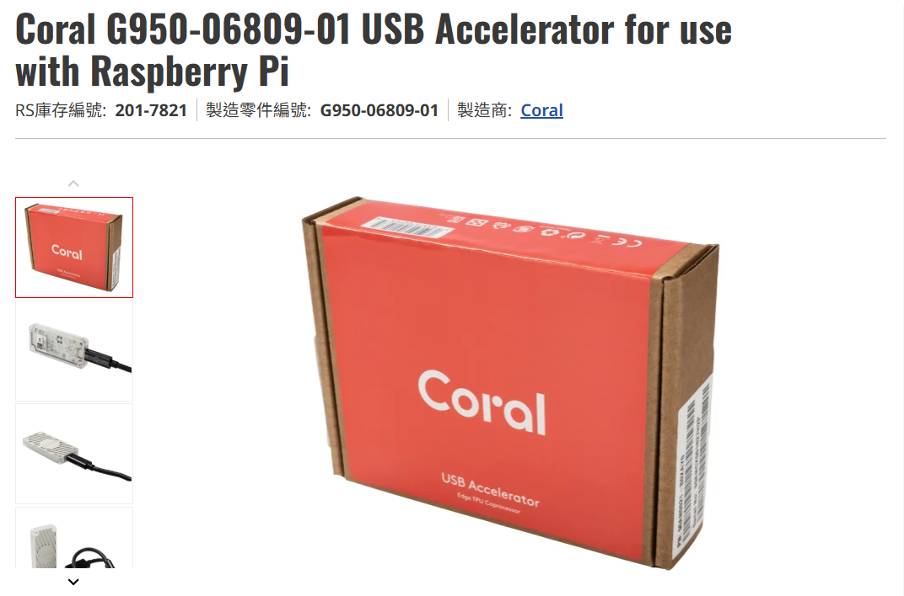
Possible Improvement
Coral USB Accelerator can help AI model computational task.
Also improve power consumption issue, which the original Raspberry Pi 5 has when running AI models.
This solves the issue of the weak performance issue of Raspberry Pi 5 on AI models.
Cost is around 2500 NTD
Product link

Slide 24
Ethical Framework
Informed Consent: Obtaining written consent from all participants.
Data Security: Ensuring data is de-identified, encrypted, and stored in compliance with regulations like Taiwan's Personal Data Protection Act.
Minimizing Harm: Training the research team and providing support resources for participants.
Ethical Approval: Submitting the protocol for review by Tatung University.

Slide 25
Potential Challenges
  Surrounding Light Impact on the rPPG detection
    Normal RGB cameras are going to be heavily influenced by the environmental lighting. In bright environment and dark environment, the RGB camera will have unreliable readings for the detections. With prior experience, NIR cameras can greatly reduce the influence of the bright environment. But the actual performance still needs to be tested.
  High computational load
    The model runs two tasks in parallel which could cause high computation load. To address this issue, knowledge distillation could reduce computation power by transferring knowledge learned by larger model to a smaller and efficient model. (Knowledge distillation)This enables the smaller model to have faster inference and deployment of less powerful hardware.
  Lack of real time responsiveness
    The proposed approach lacks real time responsiveness because of high computational load which causes latency during inference. Implementing knowledge distillation could reduce inference time.

Slide 26
Hypothesis
The proposed approach enhances drivers’ safety on the road with the help of the monitoring system. RPPG and heartbeat detection can help determine whether the drivers are in good driving condition. The warning system can help warn drivers whenever drivers have subpar driving conditions. Drivers will have safer road experience when using this system while driving.

Slide 27
Project Timeline
1. Introduction
2. Research Methodology
3. Project resource
4. Project Timeline

Slide 28
Phase 1: Planning and Development (Aug - Dec 2025)
This initial phase focuses on laying the foundational groundwork for the project.
Research & Ethics: Conduct a comprehensive literature review, survey existing intellectual property, and establish ethical data collection protocols.
Prototype Development: Assemble the core hardware system, including the RGB camera, IR camera, Raspberry Pi, and Pulse Oximeter.
Algorithmic Design: Develop and fine-tune the CNN, LSTM, NN, and rPPG algorithms for monitoring driver readiness.
Experimental Design: Create a detailed framework for lab-based testing and simulated driving scenarios.

Slide 29
Phase 2: Testing and Analysis (Jan - Apr 2026)
This phase involves collecting and analyzing data in both controlled and real-world environments.
Data Collection: Gather data from participants in a simulated lab environment, followed by field testing in real-world driving conditions.
Multi-modal Analysis: Apply machine learning algorithms to classify driver readiness and identify potential issues.
User Assessment: Collect qualitative feedback from participants to assess the system's usability and identify areas for improvement.

Slide 30
Phase 3: Prototype Enhancement & Dissemination (May - July 2026)
The final phase focuses on validating the system's performance and sharing the project's findings.
Validation: Compare your system's performance against existing technologies and use statistical methods to validate your results.
Dissemination: Prepare academic papers, conference presentations, and materials for stakeholders in the automotive industry.
Intellectual Property: File a patent for the new AI driving monitoring system.

Slide 31
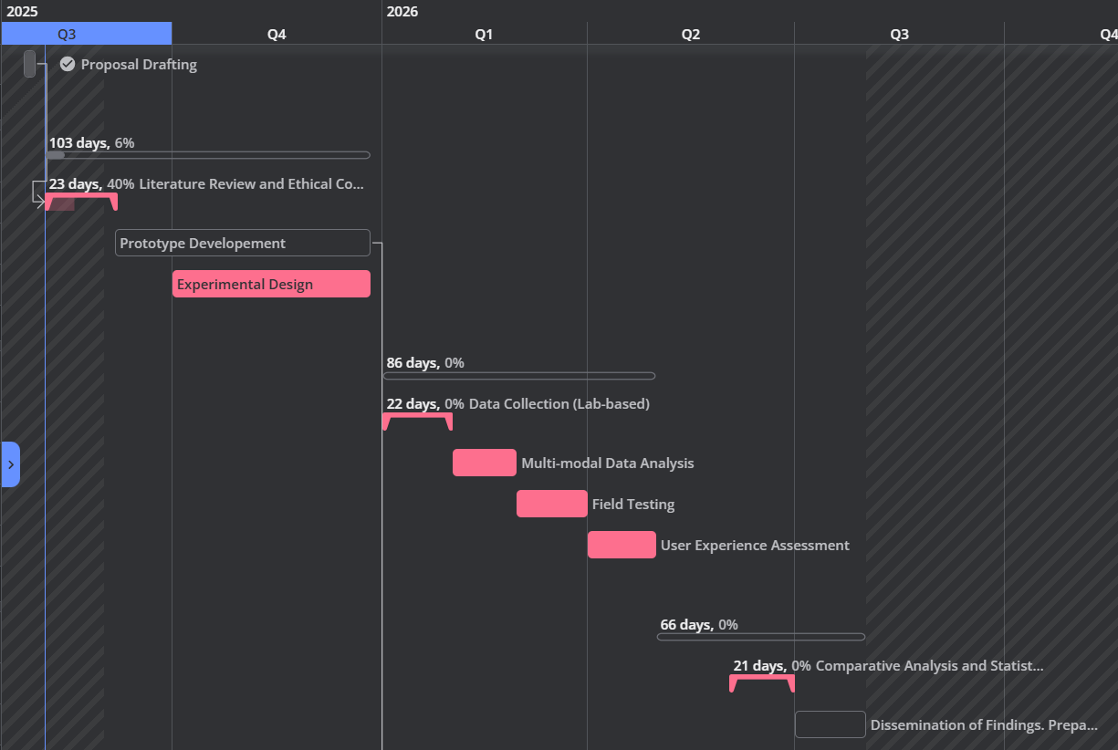

Slide 32
Thank you

